Slide 2
1920’s Prohibition & Parties

Slide 3
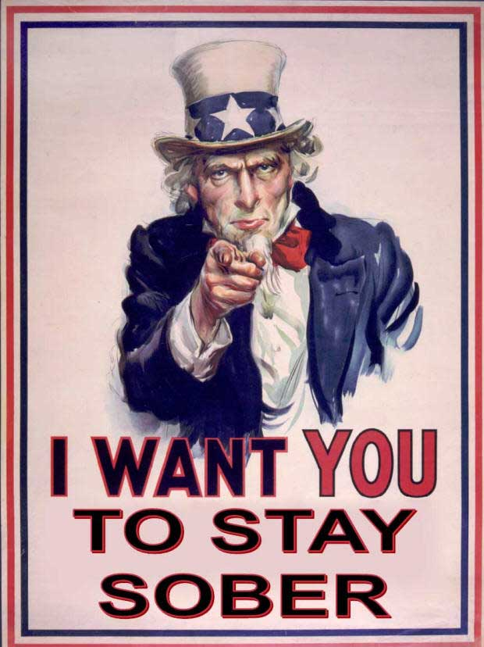
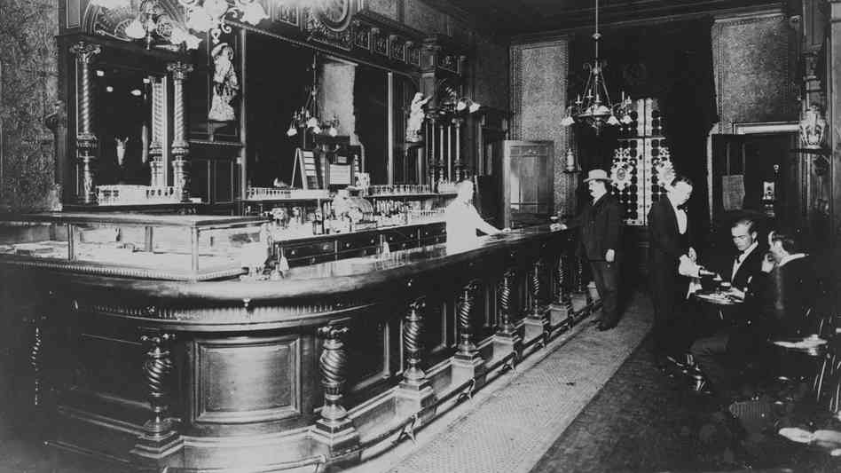
Prohibition:
January 16th 1920
The Polices job
’Speakeasies’

Slide 4
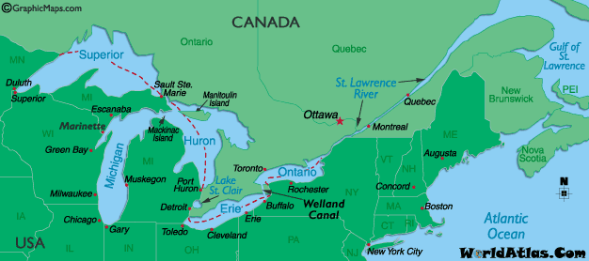
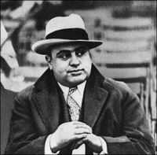
The alcohol…
Smuggled in from Canada
Aloud to make a certain amount at home
For Church
Everyone knew about it
Gangsters

Slide 5
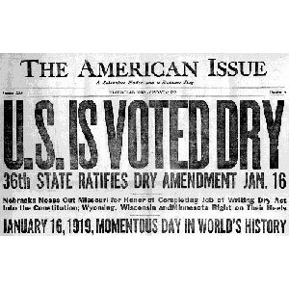
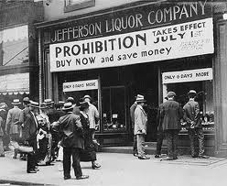
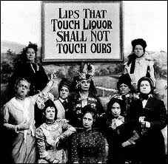
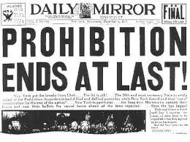
18th amendment
Prohibited alcohol
Why?
1933

